Slide 1



Slide 2
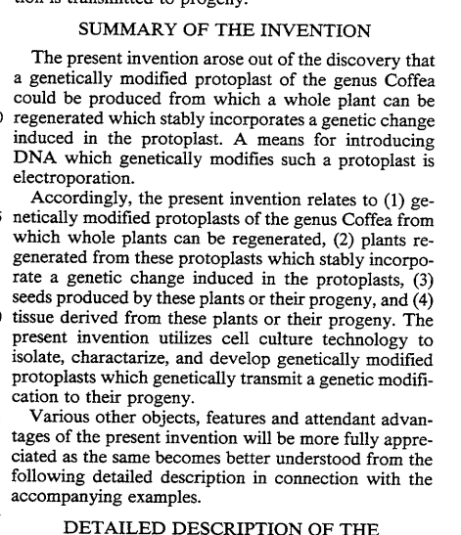
Stably transformed Coffea arabica plant cells, derived from protoplasts and capable of regeneration, are disclosed.
Problem this patent is trying to solve:
lengthy time for fruit development and 2-4 year bean-to-bean generation time (lengthy + costly)
traditional breeding techniques have been unsuccessful because C. arabica is tetraploid, while other species are diploid
Stable genetic modifications
EXPIRED IN 2011- FEE RELATED
Notes:
1498691824006584475-05334529

Slide 3
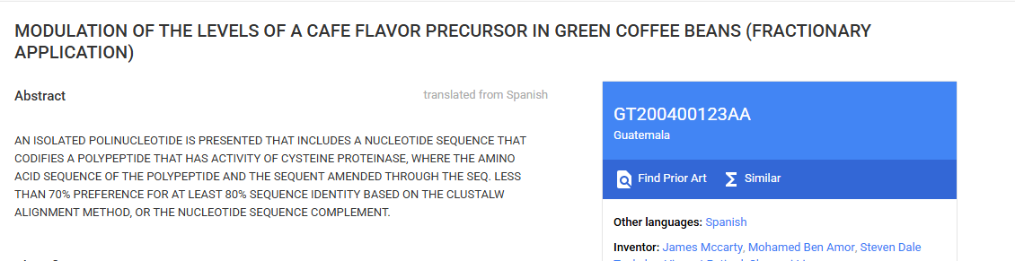
MODULATION OF THE LEVELS OF A CAFE FLAVOR PRECURSOR IN GREEN COFFEE BEANS (FRACTIONARY APPLICATION)
published in Guatemala in 2009
Notes:
GT200400123AA - MODULATION OF THE LEVELS OF A CAFE FLAVOR PRECURSOR IN GREEN COFFEE BEANS (FRACTIONARY APPLICATION) - Google Patents

Slide 4
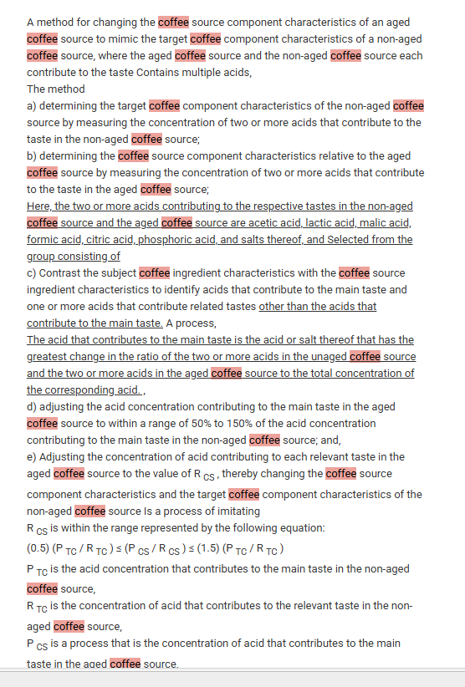
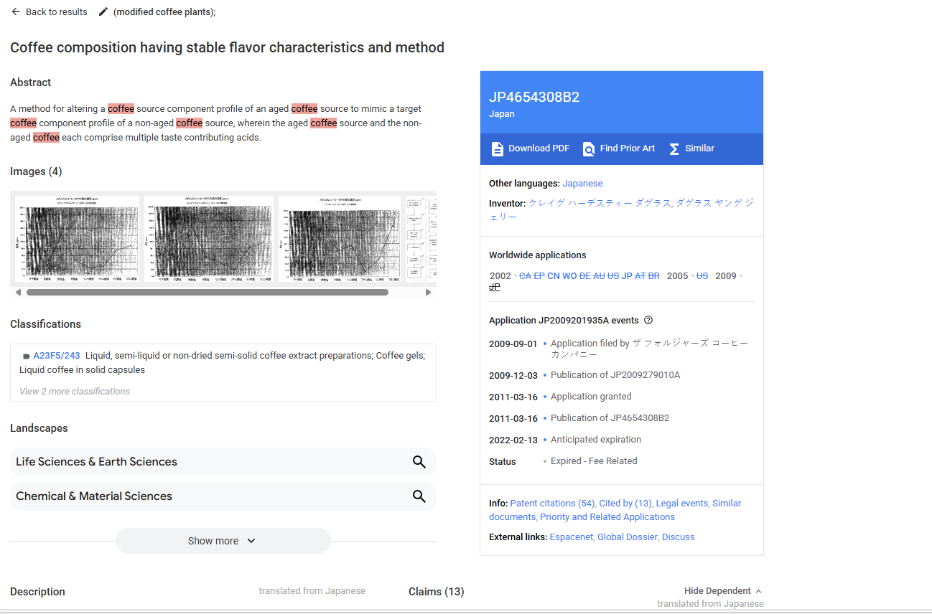
Coffee composition having stable flavor characteristics and method
Expired in 2022 - Fee Related
Notes:
JP4654308B2 - Coffee composition having stable flavor characteristics and method - Google Patents

